Slide 1
Research & knowledge transfer model of Mondragon University
Thematic University-Business Forum

Slide 2
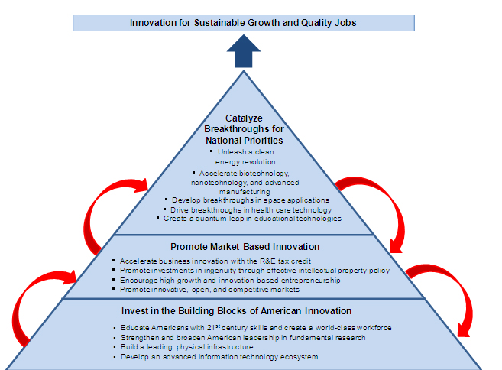
President Obama’s Strategy for American Innovation
America’s future economic growth and international competitiveness depend on our capacity to innovate. We can create the jobs and industries of the future by doing what America does best – investing in the creativity and imagination of our people.
To win the future, we must out-innovate, out-educate, and out-build the rest of the world. Innovation-based economic growth will bring greater income, higher quality jobs, and improved health and quality of life to all U.S. citizens.

Slide 3
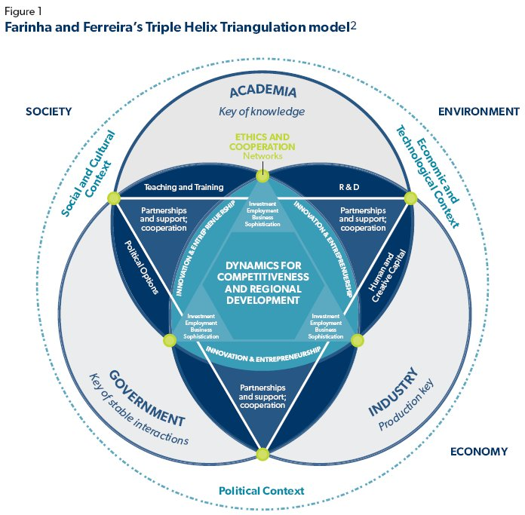
Impact of a university in the region
Mission of the university
  Increase knowledge
    New workers
    Scientific results
  Transfer knowledge and technology
How to impact in the region
  Excellence in education
    So students stay in the region
  Excellence in research
    New products and services
  Excellence in transfer and collaboration
  Proximity

Slide 4
Collaborative research and knowledge transfer model
Critical mass
  Excellence in research
  Knowledge transfer
  Innovation
  Future engineers and researchers for industry and Technological Centres
Excellence
EXCELLENT
COLLABORATIVE
RESEARCH
Long term
Focus and alignment
  From Basic research to Innovation
  Specialization
  University + Technological Centres + Industry
Specialization
Long term
  Stability of research and researchers
  New talent
  Co-funding
  Special tariffs

Slide 5

Collaborative research and knowledge transfer model
TRAINING: Technicians and researchers

Slide 6
Collaborative research and knowledge transfer model

Slide 7
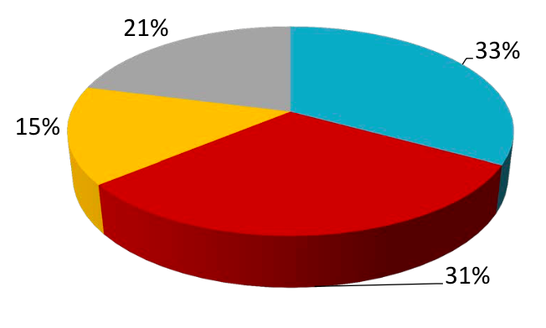
Collaborative research and knowledge transfer model
Some figures
17 long term collaborative research contracts
Over 300 projects per year (2/3 funded by industry)
Private R&D funding: 60% of the budget
  Non-competitive R&D funding < 13% of the budget
Founder and directly involved in BIC GipuzkoaArrasate/Saiolan
  Business innovation centre
Over 5000 students in professional training courses
100% students in a one year full-time industrial/research project
  Both undergraduate and master students
80% of PhD students funded by companies
  Including industrial doctorates
Competitive public funding (H2020…)
Student fees
Non-Competitive public funding (for education, R&D…)
Technology transfer (private R&D contracts)
[Mondragon University – Faculty of Engineering funding model]

Slide 8
Collaborative research and knowledge transfer model
Some figures
Applied research incomes per researcher-lecturer

Slide 9
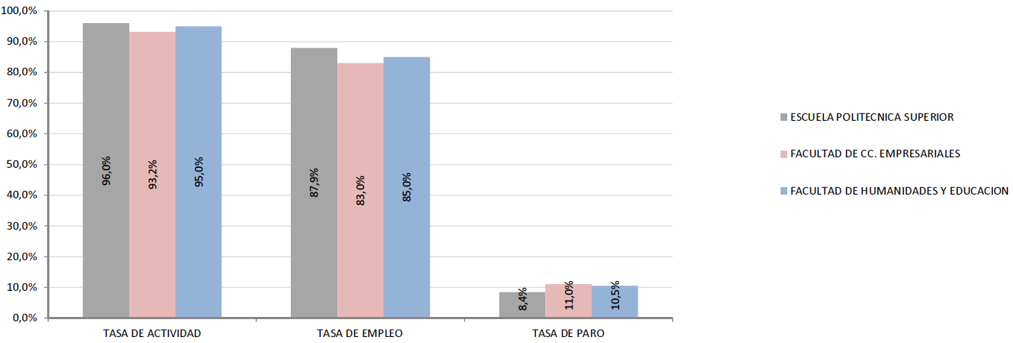
Employment rate (graduates of 2012)
[Datos y cifras de Estudio de Incorporación a la Vida Laboral PROMOCIÓN UNIVERSITARIA DE GRADO DE 2012, LANBIDE 2016]

Slide 10
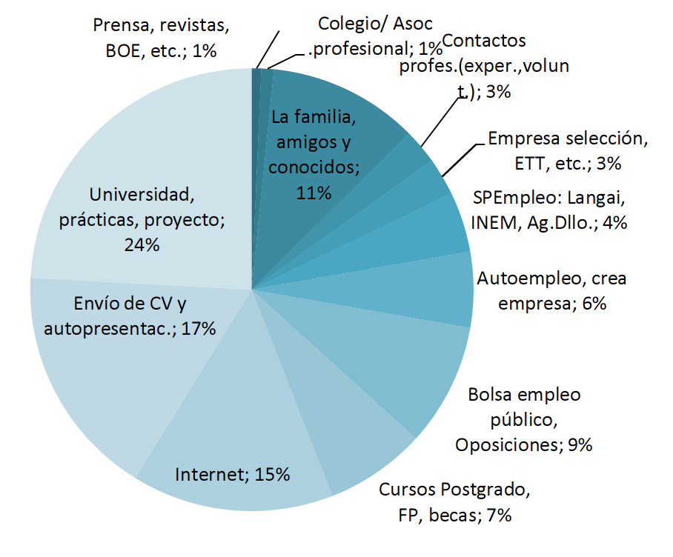
Channels of access to employment
[Datos y cifras de Estudio de Incorporación a la Vida Laboral PROMOCIÓN UNIVERSITARIA DE GRADO DE 2012, LANBIDE 2016]

Slide 11
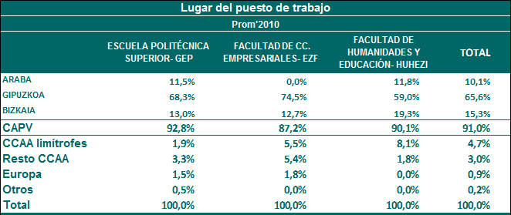
Job location
[Datos y cifras de Estudio de Incorporación a la Vida Laboral PROMOCIÓN UNIVERSITARIA DE GRADO DE 2012, LANBIDE 2014]

Slide 12
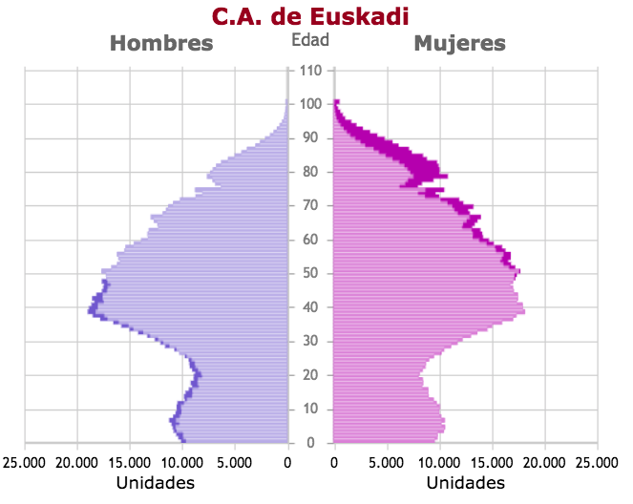
Future challenges
For the faculty of engineering
  Attract talent
  Boost STEM studies
  Increase specialization and quality of our focused fundamental research
  Increase alliances and collaboration with other regions and countries
  Give a better R&D service to SMEs
For the Basque Country
  Create knowledge and innovation based jobs and industries
    Increasing R&D funding
    Making better use of resources
    Improving knowledge transfer
    Bring the university closer to industry
    Boost innovation and promote entrepreneurship

Slide 13
Eskerrik asko
Muchas gracias
Thank you

