Slide 1

developing enterprising mind-sets in a creative curriculum
r.sant@arts.ac.uk

Slide 2
3 things we know about our graduates’ futures…

Slide 3
They need to have done stuff!
“Almost half the recruiters who took part in the research repeated their warnings from previous years – that graduates who have had no previous work experience at all are unlikely to be successful during the selection process and have little or no chance of receiving a job offer for their organisations’ graduate programmes.”
“Recruiters have confirmed that 32% of this year’s entry-level positions are expected to be filled by graduates who have already worked for their organisations, either through paid internships, industrial placements or vacation work.”
High Fliers 2016

Slide 4
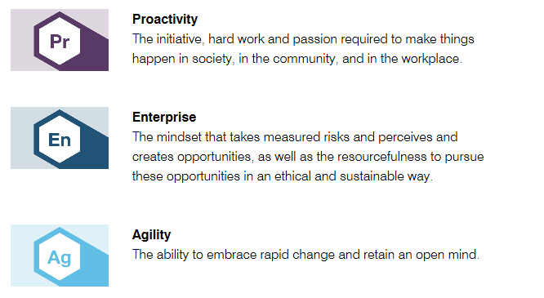
Making Things Happen
We will support our students to practice and apply their learning in a variety of situations in the University, workplace and community. These experiences will enable our students to develop the following attributes:

Slide 5
Continuous rolling selection processes
“48 per cent of graduates in work were engaged in multiple activities or portfolio working at the time of the survey, typically combining paid employment with self employment, working voluntarily, or developing their creative practice; 30 per cent combined two work activities; 13 per cent had three; and five per cent of graduates combined four different types of work activity.”
Creative Graduates Creative Futures 2009
“29% of UAL graduates self employed or starting a business within 6 months of graduating”
DLHE 2015

Slide 6
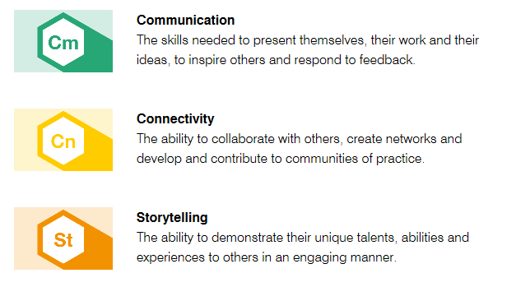
Showcasing abilities and accomplishments
We will enable students to communicate about themselves and their ideas, as well as develop their own narratives. They will be open to receiving feedback and adapt to different situations, demonstrating the following attributes:

Slide 7
Preparing for the unpredictable
Self‐confidence and self‐management were considered to be the most important to careers, yet they were felt to be less well‐developed than core creative skills. Creative graduates have strategies for coping with unstable employment conditions and this is significant as we see graduates in all subjects coming into a more uncertain employment market.
Creative Graduates Creative Furtures2009
“The character of this changing world is indifferent to tradition….. Unforgiving of frailty. No respecter of past reputations. It has no custom and practice. It is replete with opportunities, but they only go to those swift to adapt, slow to complain, open, willing and able to change.”
Tony Blair – labour Party conference 2005

Slide 8
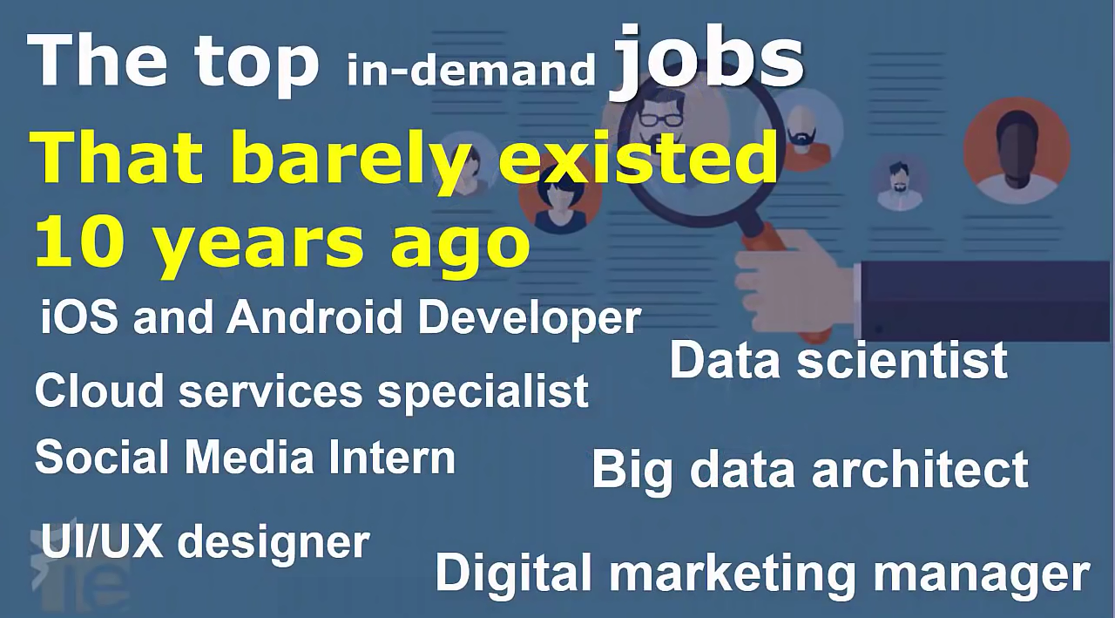
For example….

Slide 9
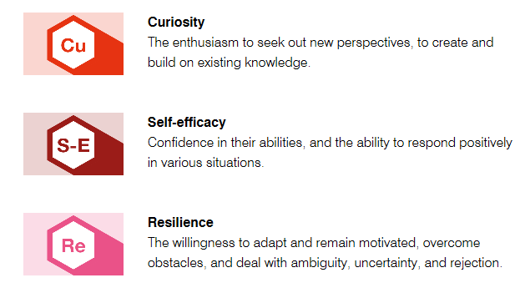
Life-wide Learning
We will equip our students to thrive in uncertain futures and navigate change by developing the following attributes:

Slide 10










Bringing it all together

