Slide 1

Nanomaterials for conservation of European architectural heritage developed by research on characteristic lithotypes
Coordinator: Professor Andrea Lazzeri,
University of Pisa (INSTM)
University Bussiness Forum Basque Country. Session 2 ‘Cultural Enterpreneurship’. 18th October 2016
Fundación Catedral Santa María/Santa María Katedrala Fundazioa

Slide 2
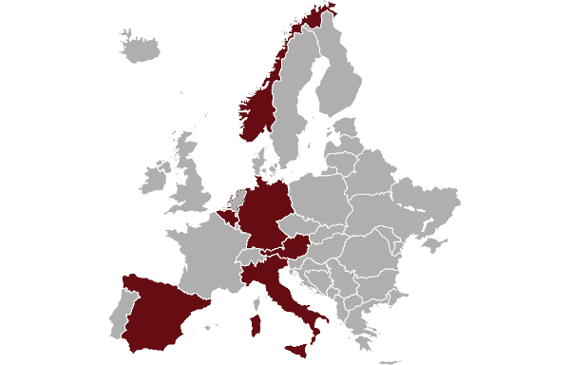
Consortium
19 partners from six different European countries
Research Centres:
Consorzio Interuniversitario Nazionale per la Scienza e
Tecnologia die Materiali (Coordinator), Italy
Otto-Friedrich-Universität Bamberg, Germany
Karlsruher Institut für Technologie, Germany
Universität für Angewandte Kunst Wien, Austria
Technische Universität Wien, Austria
Public Bodies/Non-Profit Organisations:
Opera della Primaziale Pisana, Italy
Ministero dei Beni e delle Attivitá Culturali d del Turismo, Italy
Metropolitankapitel der Hohen Domkirche Köln, Germany
Fundación Catedral Santa Maria , Spain
Diputación Foral de Álava, Spain
Dombausekretariat St. Stephan, Wien, Austria
Kommunal- OG Modernisierungsdepartementet, Norway
Companies:
Warrant Group S.r.l. (Project Manager), Italy
Colorobbia Consulting S.r.l., Italy
Chemspec S.r.l., Italy
Wiedemann GmbH, Germany
Tecnologia Navarra de Nanoproductos S.l., Spain
Architectenbureau Bressers, Belgium
Organic Waste Systems NV, Belgium

Slide 3
Objectives
“Key tools” for restoration and conservation:
of a large variety of stones
in various European climatic areas
by evaluating life cycle criteria
by transfer of knowledge up to demonstration
stage (production and application)
including treatment of contemporary buildings

Slide 4
Scope and Challenges
Analysis of site details and stone characteristics
Durability and retreatability of measures
Nano
materials
Bio
materials
Various geographical and climate areas
Development
Production
Laboratory tests
In situ applications
Standard
ization
Stone consolidation and protection
Economic, ecological, social and cultural impact analysis

Slide 5
Implementation
Workplan with eight workpackages:
WP1: Identification of products and materials
WP2: Identification and development of nanomaterials
WP3: Laboratory application and validation
WP4: Sustainability assessment
WP5: Scale up
WP6: Analysis of socio-economic & cultural impact
WP7: Exploitation and dissemination of project results
WP8: Management

Slide 6

Prospective Benefits
Policy
Interest Groups
General Public
Science
Industries/
Services
Tourism

Slide 7

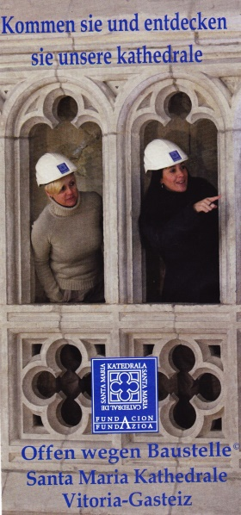
Tourism
Tourism: 588 million tourists in Europe in 2014*
Safeguarding of unique sights in Europe
Additional attention by project activities
Mitigation of admission restrictions
Novel criteria of visitor programmes
for construction sites

Slide 8

Conclusions and Outlook
Sustainable solutions for European
architectural heritage preservation
Synergies by close collaboration of research,
non-profit partners and companies
Novel nano- and bio-based products for
stone consolidation and protection
Effects on tourism, social and
cultural activities
The project NANO-CATHEDRAL has received funding from the European Union’s Horizon2020
research and innovation programme under grant agreement No 646178.

Slide 9
Thank you for your kind attention.
www.nanocathedral.eu
University Bussiness Forum Basque Country. Session 2 ‘Cultural Enterpreneurship’. 18th October 2016
Fundación Catedral Santa María/Santa María Katedrala Fundazioa

