Slide 1


The challenge of co-generation of knowledge: practical examples from the Basque Country and Norway
Miren Larrea, Orkestra-Basque Institute of Competitiveness, Deusto Foundation (DF)
James Karlsen, University of Agder, Norway

Slide 2
Our experience
We have been working for many years with regional actors (such as representatives from firms and policy makers) using an action research approach
Action research is a strategy for change through co-generation of knowledge between regional actors and researchers

Slide 3
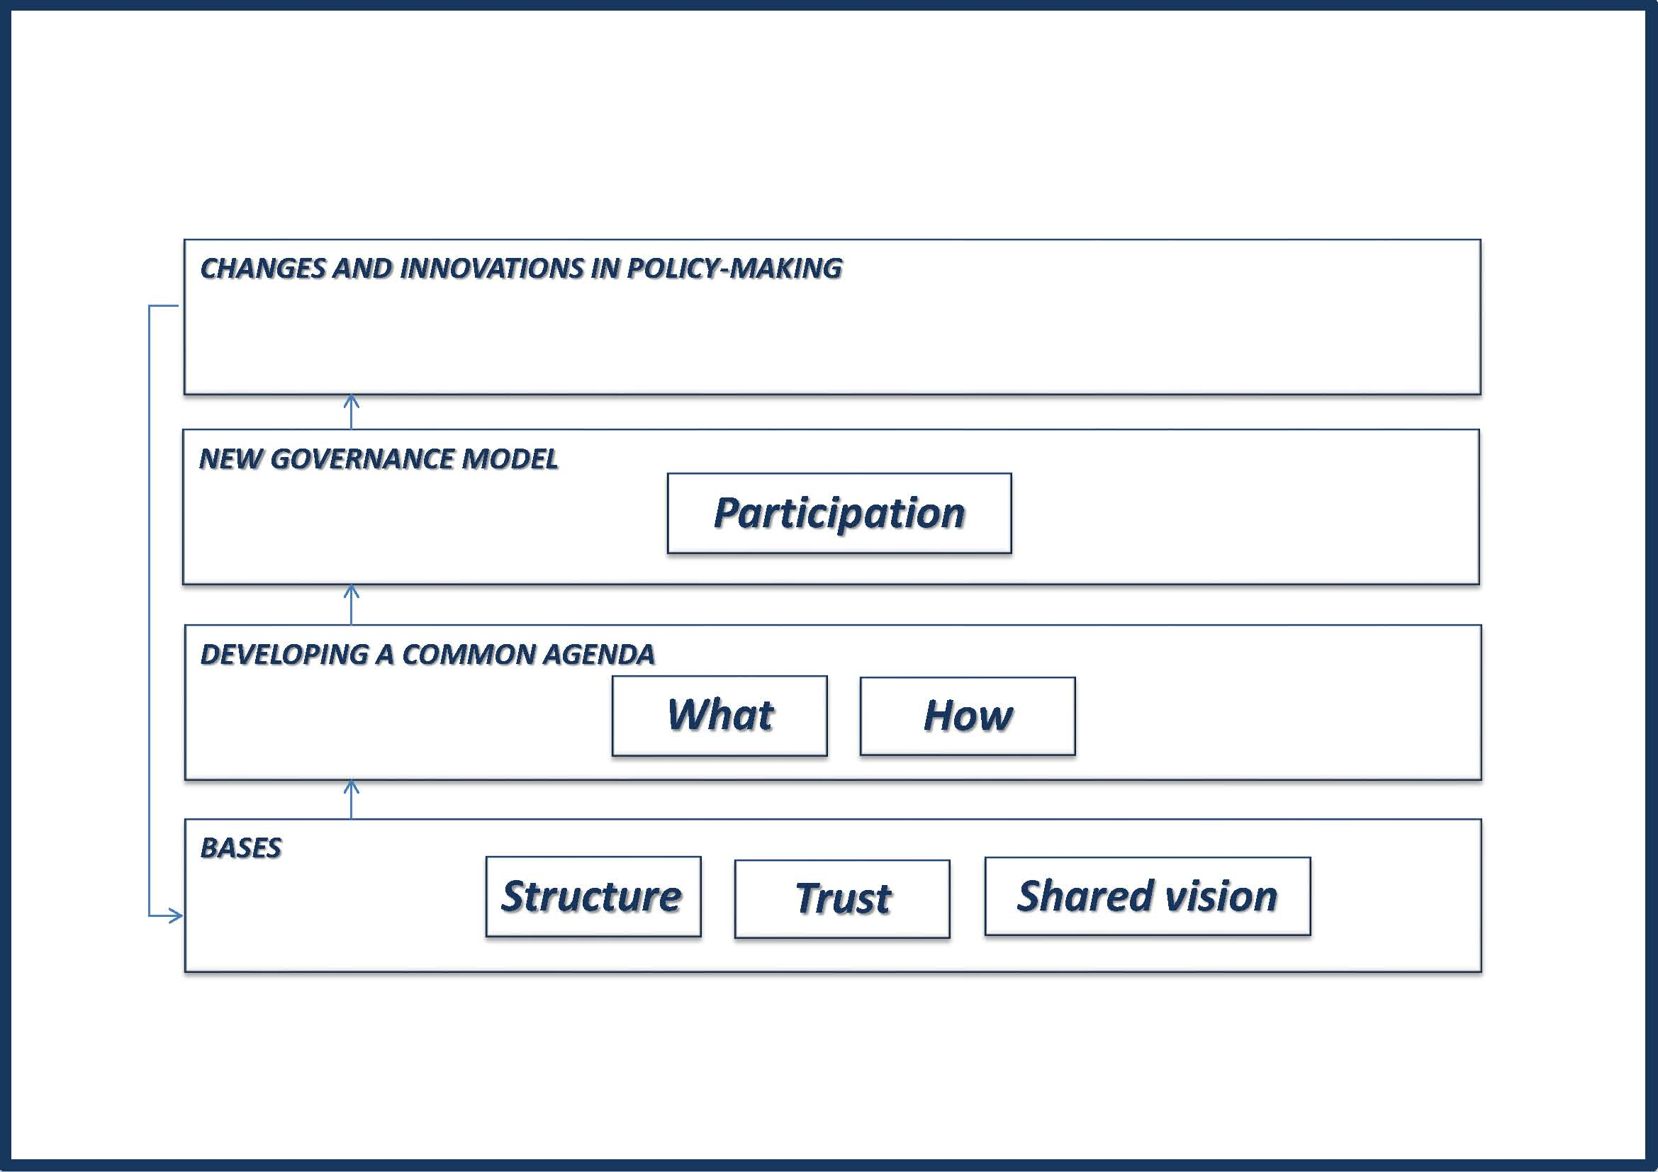
How to develop strategies for territorial development?
Action Research

Slide 4

Reflections from Norway
Universities are not structured for co-generation of knowledge
  The main missions are teaching and research
  A third mission (regional mission) is established, but there are no incitaments for co-generation of knowledge with regional actors
  Incitaments are for research (publication)
Co-generation do however happens due to individual researchers interst in collaboration with regional actors
The vocational studies such as nursery and teacher education have institutionalised cooperation with regional actors (hospitals and schools) where students can practice their knowledge

