Slide 1
A NEW MODEL FOR RELATIONSHIP COMPANIES-UNIVERSITY AND TECHNOLOGICAL DEVELOPMENT
CFAA:
ADVANCED MANUFACTURING CENTER FOR AERONAUTICS …. JUMPING FROM MRL 4 TO 7
L. Norberto López de Lacalle
norberto.lzlacalle@ehu.eus
Notes:
Well, thank you Mr Chairman for your kind introduction……
We have forty five minutes, give or take, in which I will try to do my best for giving you a global picture about how the new research center for advance manufacturing technologies in aeronautics is taking shape,
But first, My name is Norberto López de Lacalle, I am a professor at the University of the Basque country, simultaneously with the role that was entrusted me 6 months ago, for becoming director of the new CFAA (si-ef doble ei) project.
You can see our logo, following the line of those centers and units that are parts of the university without a different VAT number, but with a real and concrete purpose.
Some of you may be wondering now why my speech title is that on the slide. …….
The answer is simple: the center will live inside a global scheme and involved in the activity of university group ….where other readiness levels are already present.
But let´s get it started, passing on the summary and outline of this presentation.
Here it is.!!!

Slide 2

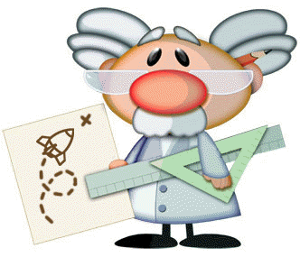
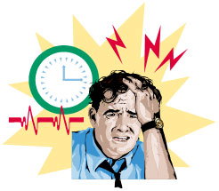
MRL: THE KEY FOR THE CFAA UNDERSTANDING
Manufacturing Readiness level (TRL/MRL)
Technology demostrators
TRL4 a TRL7
Universities, Technological centres, R&D units
Industrial innovation units and organisations
TRL1
TRL2
TRL3
TRL4
“The Death Valley”
TRL7
TRL8
TRL9
Basic principles
Technological concepts
Manufacturing proof of concept
Demo in a laboratory
Demos in an operational enviroment
Full system validated
System in a real situation.
Optimization
TRL5
TRL6
Component manuf. in a relevant environment
Manuf. system demo in a relevant environment
RELEVANT ENVIROMENT : MACHINES WITH SAME SIZE AND FUNCTIONS !!!
Notes:
Second reflection…, MRL, manufacturing readiness levels.
This is a very beautiful approach for the definition of research efforts regarding the closeness to final application.
The initial scale was proposed by NASA in the eighties, for all kind of aerospaces technologies, but it was adapted to manufacturing not a long time ago.!
Starting from the left: those levels coming to a final test on a lab demonstrator, this is level 4 or 5. Usually technological centers are able to reach this development stage. Therefore.. good ideas, results with great expectations and nice tests show how a technology may be feasible. Unfortunately the size and limitations of lab machines avoid further developments.
In the same way and looking from the right side, companies are able to climb up in the readiness levels up to level 7th, devoting for it time, expertise and resources.
But the daily production is very demanding. All of you know that real production implies an “all-time putting out of fires”, coping with unexpected situations, delays, and horrible stress from customers.
Therefore a gap is located between MRls 5th and 8th, the so-called Death Valley, because here a lot of good ideas coming from both ends can stop and die.
Looking at the death valley, the two levels involved….What is the bottom line of both risky levels?.
The keyword, or better say, the key idea, is to perform validation tests in a “production representative environment”.
For companies men that means (in plain) to use just the same machines of real production. Perhaps not exactly the same, but with the same size, ….functions, etc.

Slide 3
WHAT THE CFAA IS?
    A research facility located at the Technological Park of Zamudio.
    It looks like an industrial factory, not a lab: real size and complex machine-tools
    The CFAA legal formula is “Centro Mixto”, same VAT of University of the Basque country
      The university through the Group of Advanced manufacturing (Type A)
        It manages the centre and resources, coordinating the MRL 6,7 projects
        It develops others projects in MRL 2 al 5.
        It integrates the CFAA activity in a general axis: research+training+transference.
      The companies partnership AIE (Agrupación de interés económico)
        It proposes, drives and collaborates in MRL 6 and 7 projects
        It contributes with an starting 7-year funding agreement (7 years)
        It supplies consumables, quasi-real partpieces and experts to projects
      Public institutions (DFB y GV) give the initial funds and monitor the CFAA evolution
MRL 6-7…
Notes:
Let´s resume the outline, and let me make a rapid definition of what it is the CFAA.
The highlights or the new centers are the following ones:
It is a new facility, with the shape and size of a little factory, located at the Technological park of Zamudio.
The legal nature is a joint centre, I am not sure if it is good translation from the Spanish name, Centro mixto.
So.., it´ss a marriage of the university of the Basque Country and one industrial partnership, with similar or compatible interests. The nickname, for friends, of the association is the AIE (ei-ai-i:)!!!
Why did we use this legal form? Basically, because it did exist, there are two others in my University, in both cases, an agreement with the Spanish CSIC in the field of material physics.
The difference, in my opinion a big difference, is that in our case one of the spouses, the AIE, is a group of companies, and that implies that timing, objectives and needs are those of real production, and not the quiet and long term ones of Science.
Perhaps. other structures might be applied, but they were not. The historical evolution of the project had also much to do with it…but…… it is a looooonggggg story, and it is history as well.
In the slide, some bullets are pointing out the roles and main aspects of both “loving” members. Basically, and going straight to the point,
The university is responsible of the house, household, and daily management of the center, with the contribution of its background in applied research, and …..
The industrial partnership will bring up projects, defining targets….They will fund the yearly activity, and will provide real testpieces, support, etc.
The Basque institutions, by means of the contribution of the Basque government and the Biscay deputy council, will grant the initial funds for purchasing machines and systems, including the money for the building refurbishing.
Of course…, Public institutions will continue as a trustee of the CFAA, because the new center must never forget the social interest. On the other hand, the University of the Basque Country is public tooooo, so the project will never forget to work for the common wealth.

Slide 4
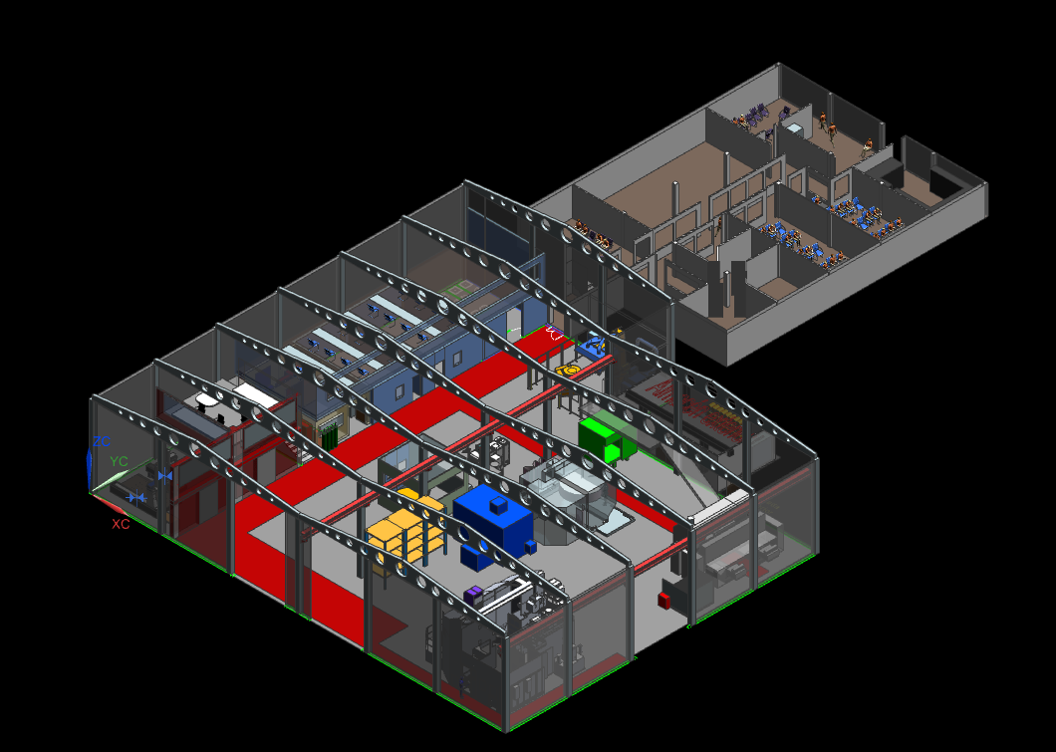
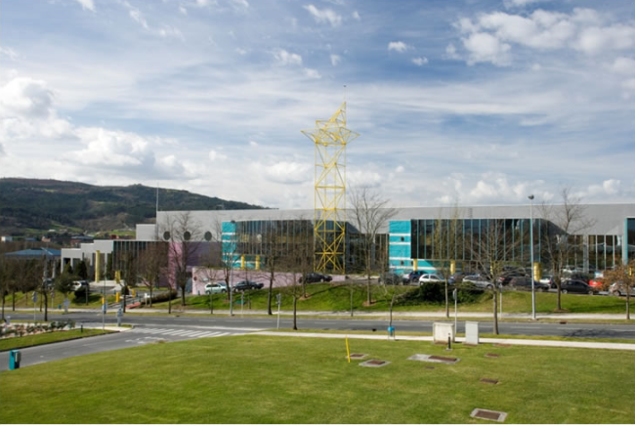

CFAA LOCATION
Building 202 at the Technological Park of Biskay (ZAMUDIO)
Five minutes from ITP
The UPV/EHU rents the building
Workshop and adjacent offices are managed by the University
airport
1500 m2 workshop, 500 m2 offices
“ Nearly a factory inside the university”
Notes:
Now it is time to show the workshop and layout.
This is the workshop and offices that we have rented. The building is THE 202 (two-ou-two) at the technological park.
At the view of the picture, an aspect is clear: this is going to be a little factory inside the university.
The daily run of it will imply some issues to solve, hummm safety, new standards to adapt, etc……..but I am pretty sure that there will be solution for everyone.
So…A challenge but an opportunity at the same time, without any doubt.

Slide 5
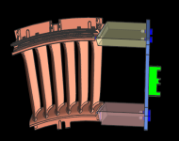
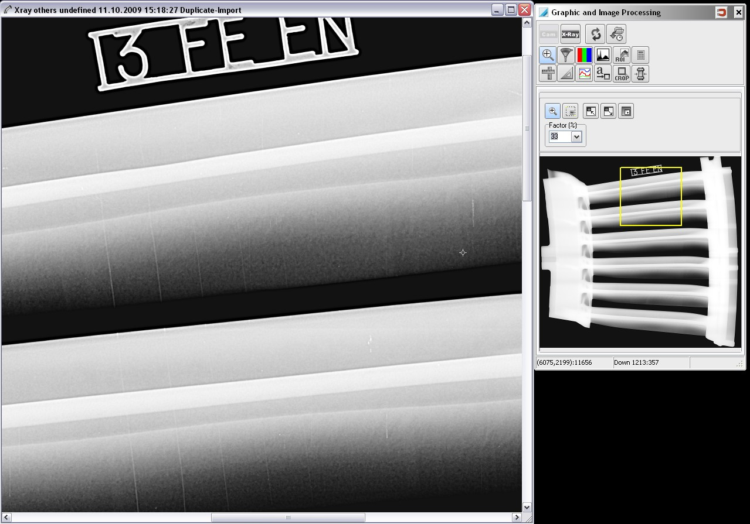
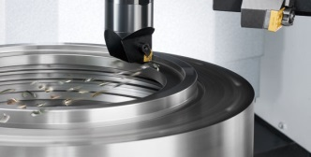
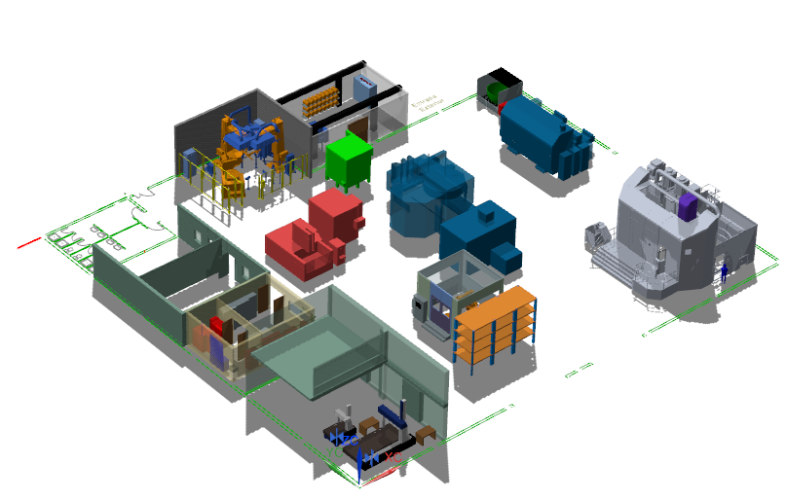
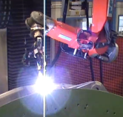
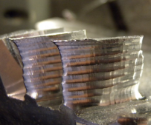
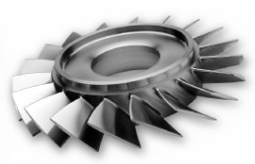
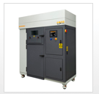
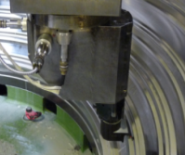
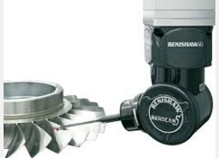
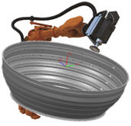
EQUIPMENTS ORIENTED TO PROJECTS
TURNING
Digital XR
EDM
5 AXIS MILL- TURN
WELDING
SLM 3D printer
TURN-MILL
FINISHING
INSPECTION
LASER
CMMs
Notes:
The plant layout and workshop room are already full; ….the next slide shows the machines in their final places.
You can see here, on the right wing, the four big machines for multiaxis and multasking machining. Here in the corner a big vertical multitasking lathe, by the company GMTK, just in the other corner a vertical lathe, by DANOBAT.
This one is a multiprocess five-axis milling machine, provided by Ibarmia. I give you the names of those that already won the public tenders.
This one is a five-axis milling and grinding machine combined, ..quite a new concept!!!!, for making integrated blade rotors. Later we will go through some slides to show machines in detail.
On this row in the central line, two robotic cells, one for welding and the other for finishing, deburring and other several purposes.
Between them there are enough room for two electrodischarge machines, one of sinking type and the other of wire type. Let me point out … here… the cabin for digital X-ray inspection with tomography…..just here!!
In the double-deck annex, there are several rooms.
One is for two CMMs (si em ems) equipped with the most cutting edge touch probes, and…. in this place an SLM machine, that is, a 3D metal printer of the sort powder bed, provide by Renishaw, with all kind of accessories such as furnaces and filters.

Slide 6
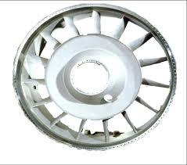
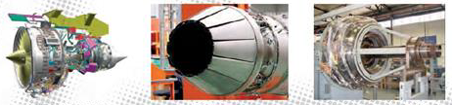



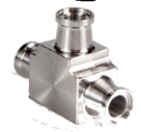
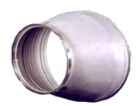
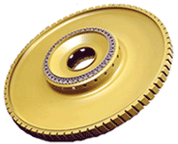
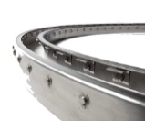


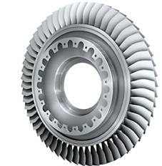
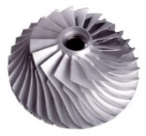

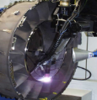
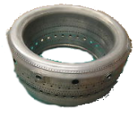

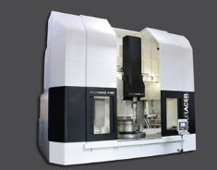
CFAA GLOBAL AIM: “RESULTS ORIENTED” ACTIVITY
TECHNOLOGY
PEOPLE
RESOURCES
KNOWLEDGE
RESULTS – Tech. and economic
MACHINING
MULTITASKING
MULTIAXIS
SUSTRACTIVE
SINTERED LASER
LASER DEPOSITION
ADDITIVE
COMPANIES
“Practical point
of view”
“Knowledge”
Skilled technicians
MRL 8,9
Structures
Externals
Exhaust
LPT
DEEP SLOTS, THIN HOLES
EDM
TIG, LASER, PLASMA
WELDING
PIECE ON BOARD
TOOL ON BOARD
DEBURRING
Casting
NGV
Ducts
Fittings
DIGITAL RX - TOMOGRAPHY
INSPECTION
HIGH SPEED TOUCH, LASER
MEASURING
NX, VIRTUAL SIMULATION, MODELS
CAM
FORCES, ENERGY, VIBRATIONS
MONITORING
LPT housing
Disks
Seals
Shafts
MULTIPROCESS VERTICAL LATHE
MULTITASKING MILLING MACHINE
FI-AXIS MILLING AND GRINDING
DOUBLE RAM VERTICAL LATHE
EDMs: SINKING AND WIRE
MACHINE
TOOLS
ROBOT CELLS
Blisks
impellers
TIG PLASMA CELL
DEBURRING CELL
UPV/EHU and others
“Knowledge”
Models
Formation
Fundamentals
Researchers
Students
MRL 2-5
METAL 3D PRINTER
3D SLM
CMM WITH REVO
CMM WITH LASER SCAN
CMMs
Repairs
Chambers
R&D demonstrators
Digital RX CABINE
Machine Tools:
Tech Improvements
Trusted partner
“Name” in the market
Showcase effect
MACHINES- FACILITIES
Notes:
How to put the entire center in one slide…??? this is a big challenge…
This is the final result!!!!!. Don´t worry with the huge amount of information, we will go through the technologies and machine in a moment.
However the powerful idea here is basically one: all things are oriented to obtain results for the companies, and.. in the very end, that´s imply to impact on the regional GDP.
So, machines, technologies, our different backgrounds, scopes and strengths have to seek for reaching the sweet point.
Which is it? In only one sentence: working together for achieving a real improvement in manufacturing processes, and through it, to impact in the “loss and profit” accounts.
For the time being, the CFAA is only thinking in the aero engine components, a niche where machine tools and production facilities are fundamental.
This statement explains which partners are in the AIE and which could become members in the non-distant future.

Slide 7
video
https://www.youtube.com/watch?v=I68eMpUvJDU

