Slide 1
higher Education AND S3:
TOWARDS THE ENGAGED UNIVERSITY?
Kevin Morgan (Cardiff University)
Thematic University-Business Forum
San Sebastian
18/19 October 2016

Slide 2
Mission Creep: what are universities for?
Traditional missions of the university (teaching and research) are complicated by the growth of third mission activity (knowledge exchange)
Despite globalisation of science & technology, universities are still largely national institutions– especially in terms of regulations, funding and (under-graduate) student populations
Third mission activity tends to be heavily focused on national and regional priorities
Smart specialisation strategies (S3) create a new imperative for universities to become more engaged with their regional economies/societies

Slide 3
Models of university engagement
Three models of university engagement:
The Ivory Tower stereotype: elite engagement for the educated few
The Entrepreneurial University: selling IP/promoting spinoffs/Triple Helix etc
The Engaged University: part of an innovation ecology, which includes societal challenge engagement as well as business engagement – so social innovation as well as technological innovation
Notes:
Second model: Bayh-Doyle act in the USA and Triple helix model

Slide 4
Diversity of knowledge exchange
Universities asked to perform a catalytic and transformational role in national and regional innovation strategies
However universities need support for translational activities i.e. activities that can help translate knowledge into innovation
This is particularly relevant in less developed regions, where the entrepreneurial demand-side is weak
Knowledge exchange comes in many shapes and sizes…not just narrowly defined science and technology

Slide 5
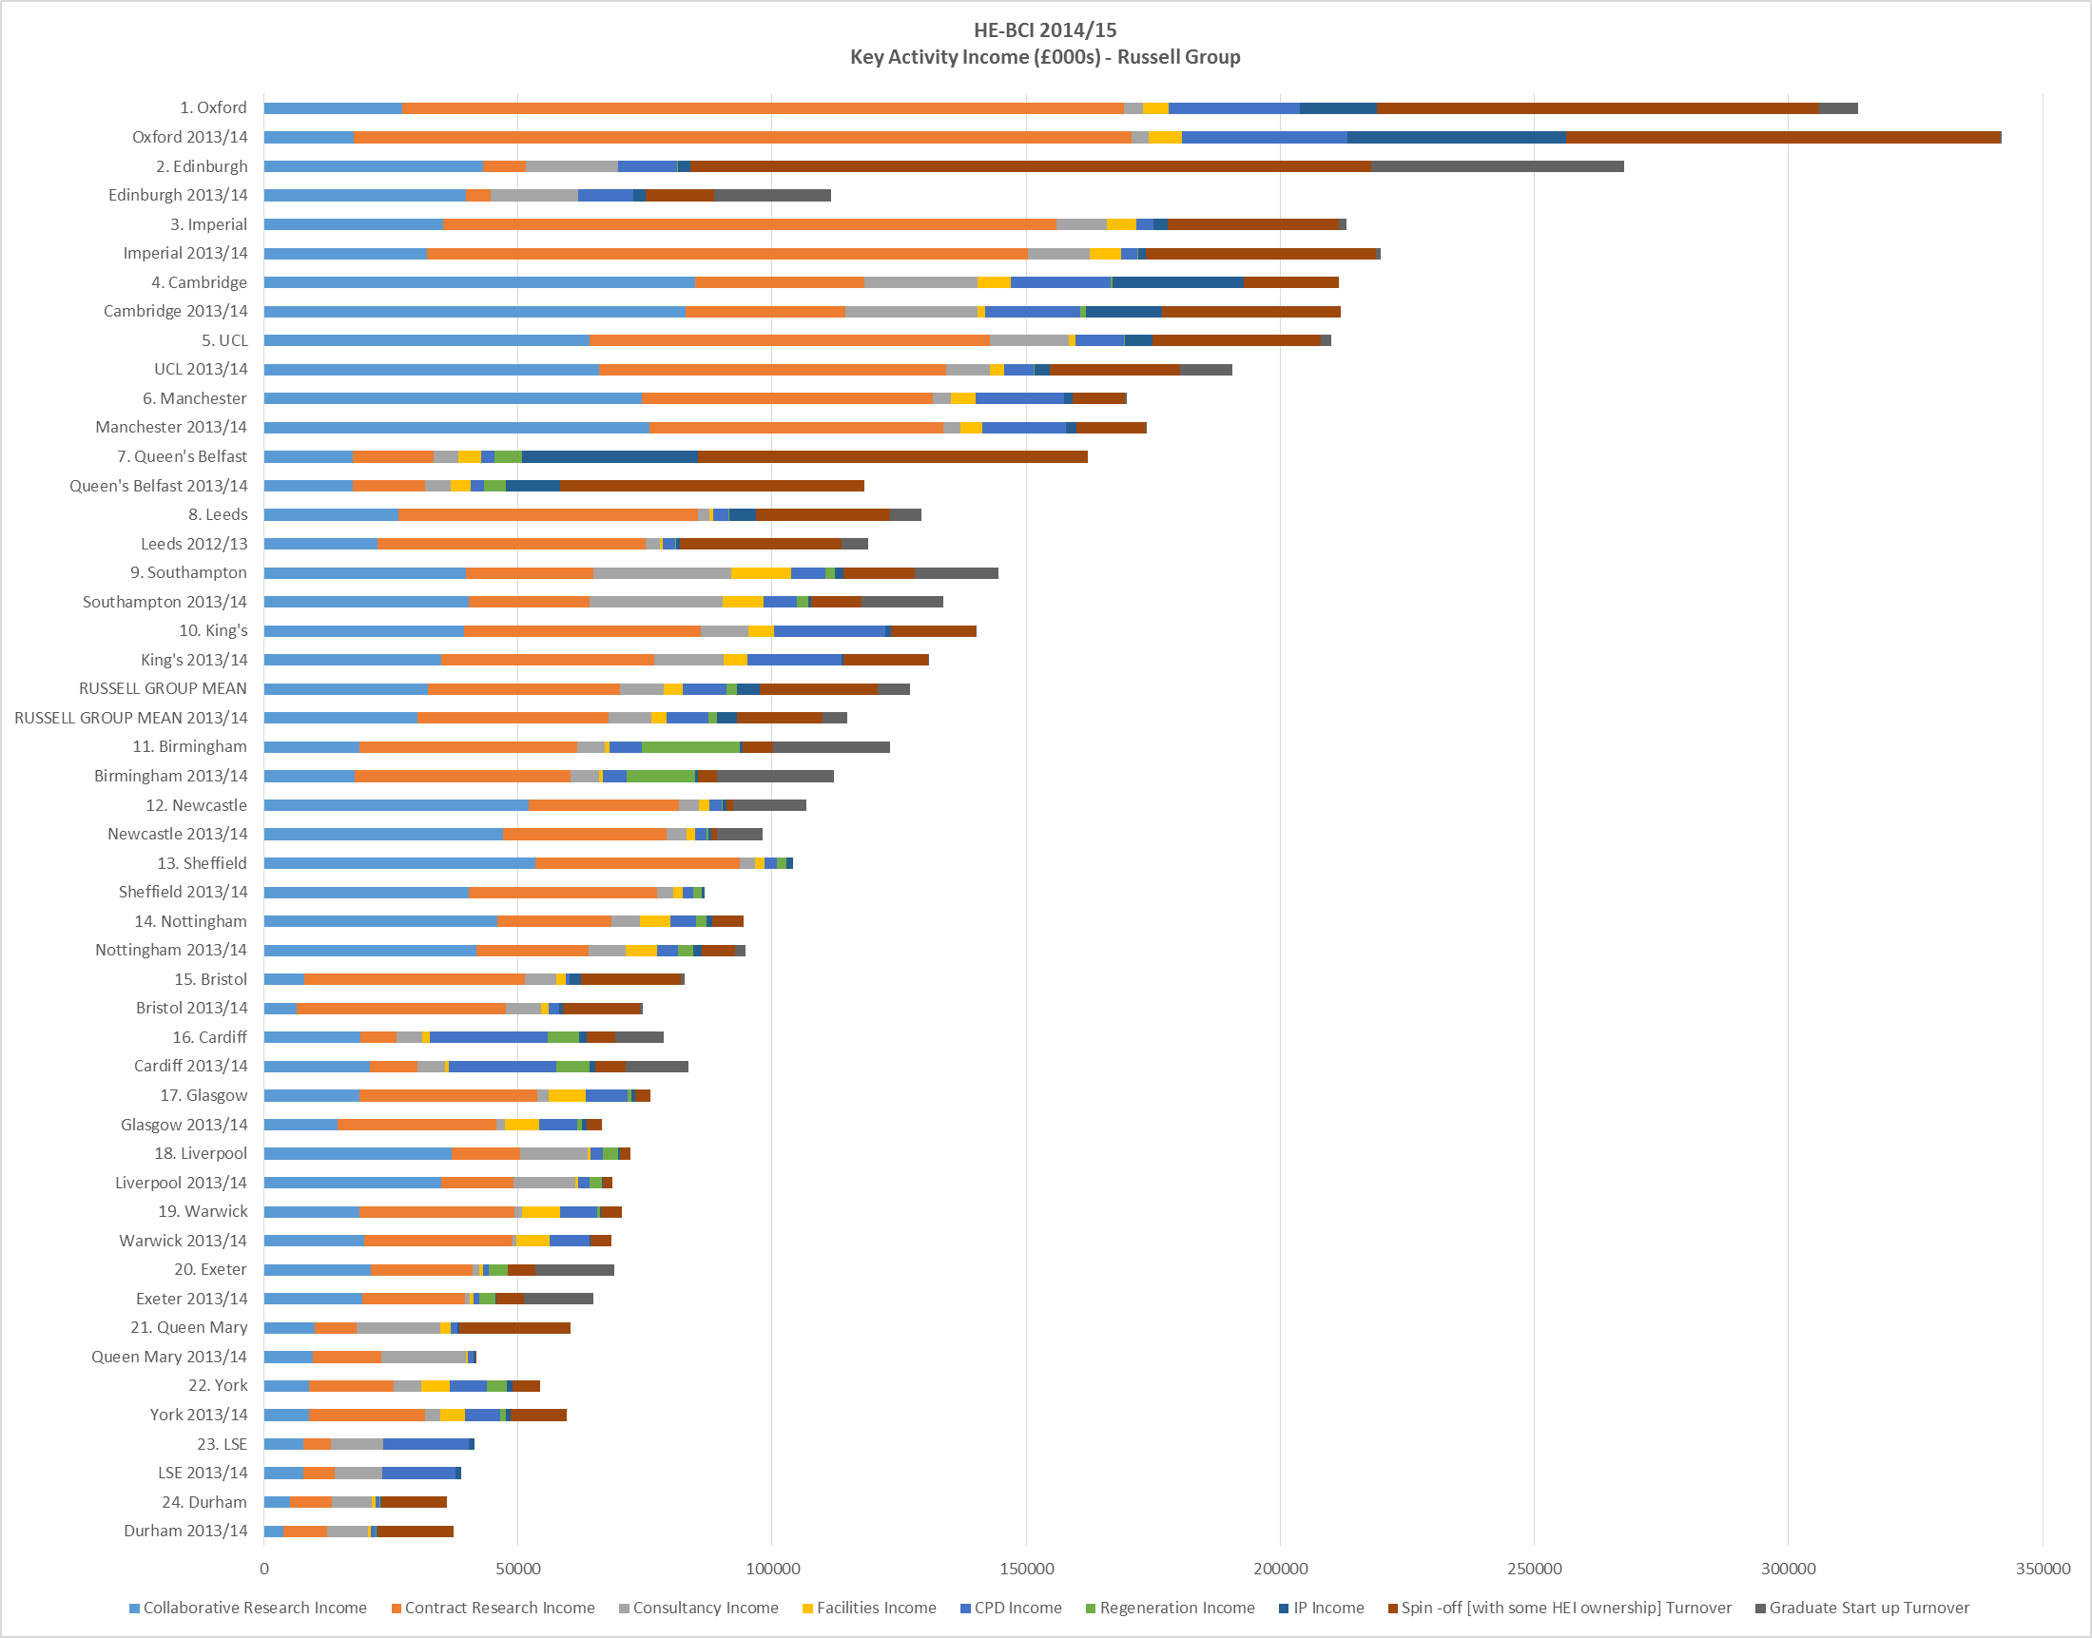
Source: (HE-BCI 2014/15)

Slide 6
Types and levels of KE engagement of university academic staff
Source: (HEFCE 2016)

Slide 7
The university as a socio-spatial institution
Capacity to engage with external partners depends on institutional characteristics:
  The type of university (research-led or teaching-heavy)
  The national context (institutional autonomy)
  The sub-national location (urban and regional context)
  The strategy of the university (culture/values/goals)
  The organisational capacity to engage (internal/external alignment)
Below the formal institutional level, academics respond to multiple (and potentially conflicting) loyalties:
  (i) to the institution (ii) to the department (iii) to the discipline (iv) to the professional rules that regulate career advancement and (vi) to subjective personal values

Slide 8
The university and its innovation ecology
Translational activities depend on the calibre of the innovation ecology:
Firms with absorptive capacity to valorise university knowledge
Upstream and downstream activities, including financial resources, KIBS, suppliers and potential clients
A variety of public and private organisations that can provide funding, political support and a stimulating/enabling regulatory environment (ie “smart state” functions)

Slide 9
The challenge of science silos
S3 presumes an engaged university that is geared up to work with its partners in the regional ecosystem (but many universities operate science silos where knowledge is trapped in labs)
Many regions still cling to the linear model of innovation in the (mistaken) belief that more university research inputs = more innovation outputs
Big disconnect with the academy, where the linear model was buried over 20 years ago
What can be done about university science silos if the linear model of innovation is alive and well in policy and practice?
New forms of university collaboration emerging – 3 examples...

Slide 10
HESS Project: multi-level collaboration
Higher Education for Smart Specialisation (HESS), a new pilot project launched by DG Education and Culture with the EC’s S3 Platform and regional stakeholders
Aims –
  to align human capital supply with S3 priorities
  to strengthen contribution of HE to regional innovation ecosystems
  to foster organisational change within selected HEIs to help them engage better with the S3 process
Action research in less developed region (NE Romania) and more developed (Navarre)

Slide 11
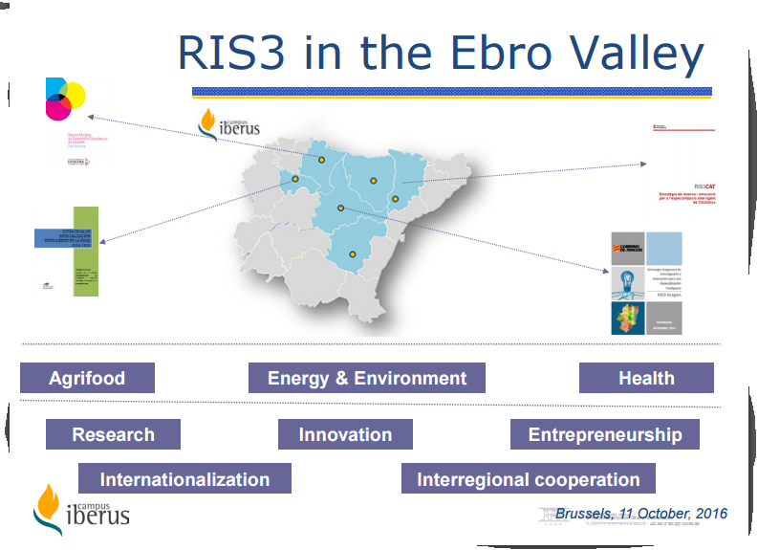
University collaboration: Campus Iberus

Slide 12
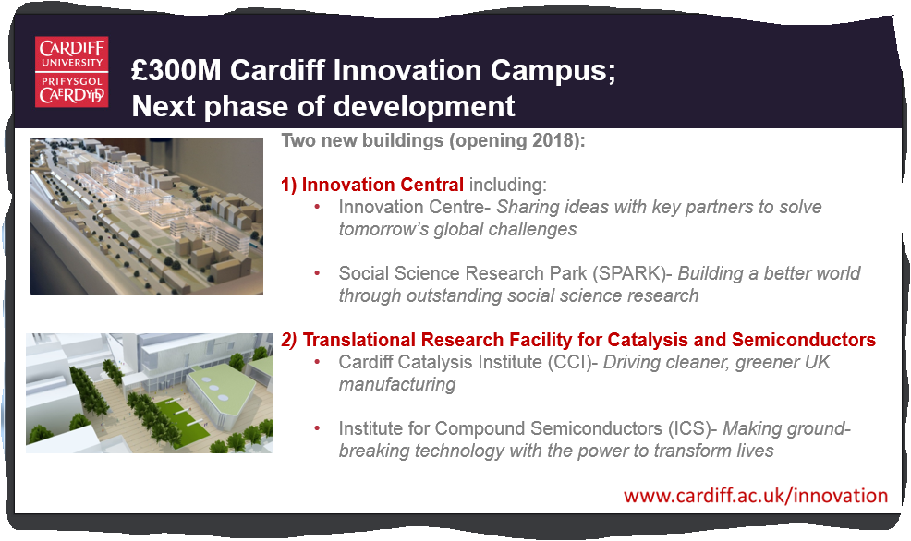
Cardiff University’s Innovation Campus

Slide 13
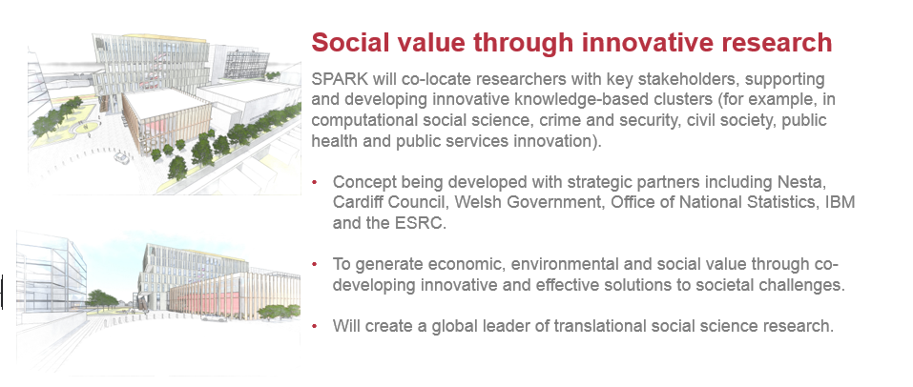
Beyond science silos...social innovation

Slide 14
Conclusions: the engaged university
Universities are under more pressure than ever before to become more engaged with and more accountable to economy and society
Capacity for external engagement depends on internal connectivity/capacity
S3 forces universities to confront their science silos, where knowledge is trapped
Universities can help to valorise knowledge (by being more open/porous) but they do not have the business acumen to substitute for firms
As Bill Clinton (almost) said – “it’s the ecosystem stupid”

