Slide 1



STAN Tool, from a theory in the lab to an industry standard
Juan-Mari Collantes, UPV/EHU
Stéphane Dellier, AMCAD Engineering
October 18th, 2016

Slide 2
OUTLINE
1 - Context of the work
2 - The beginning
3 - The participation of AMCAD Engineering
4 - The current status-quo
5 - Key elements and major difficulties

Slide 3

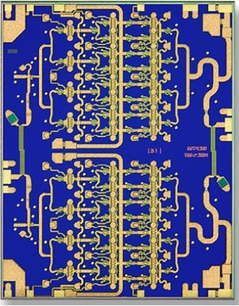

Microwave amplifiers for wireless, satellite and radar
TGA4046 Qorvo
2W Q Band High Power Amplifier
Chip dimensions 3.45 x 4.39 mm
1 - Context of the work

Slide 4
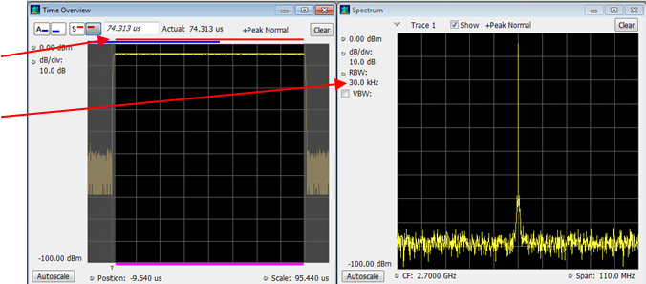
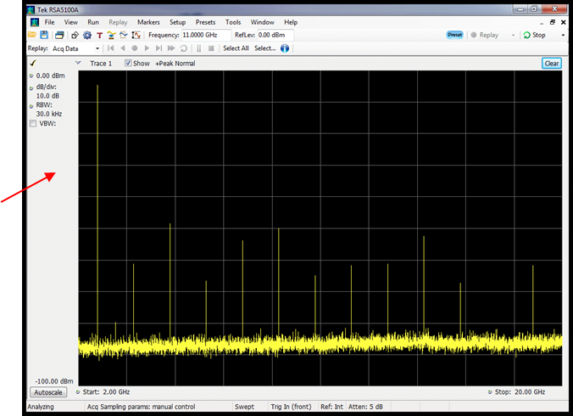
Danger: Amplifier instability
Stable
Unstable (malfunctioning)
New iteration required: $100K-150K and 3-6 months
1 - Context of the work

Slide 5
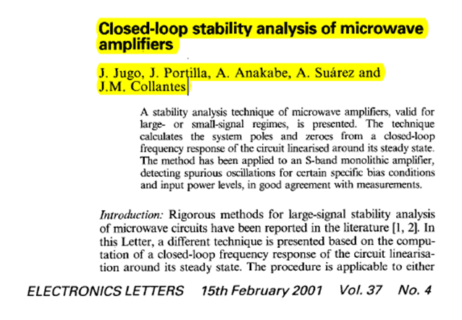
In 2001 we published a theory on how to detect oscillations in microwave amplifiers
2 - The beginning

Slide 6
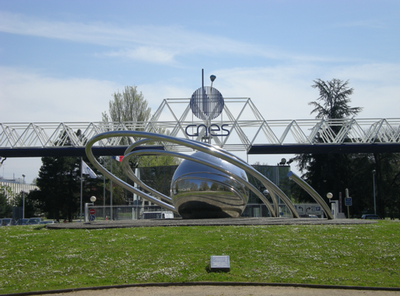
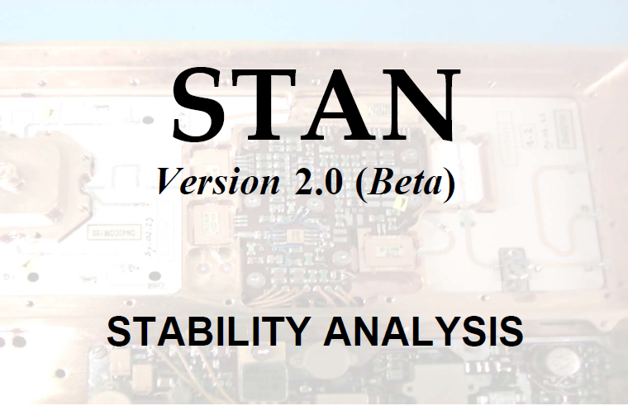
In 2002 we start a cooperation with CNES that provided funds and technical expertise
We end up with an “in-home” made tool called STAN (2006)
Electronic companies interested in STAN:
Motorola,
Freescale,
Thales Alenia Space,
Raytheon,
Hittite Microwave,
etc.
2 - The beginning

Slide 7


How to proceed next ?
Deliver it as
free software?
Commercialize it ourselves?
2 - The beginning

Slide 8
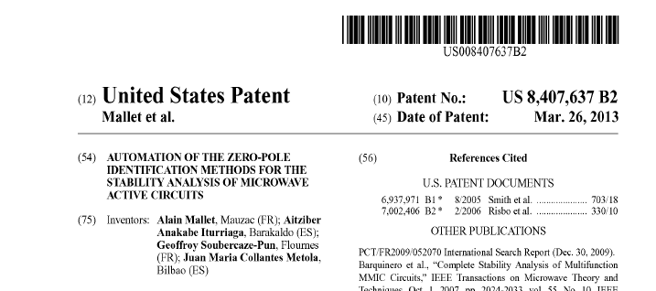

Strategy adopted eventually (2008 - 2011)
1 – Sign of internal agreements between CNES and UPV/EHU to share (50%) all IP rights related to STAN
2 – Patent the automatic algorithm (France 2008, then Europe and US)
3 – Register the name
4 – License the patent and STAN Tool to AMCAD Engineering, for commercialization (2011)
2 - The beginning

Slide 9

Benefits
AMCAD worked in the same field of microwave electronics
AMCAD was already working with CNES in other projects
AMCAD had already a very powerful software tool (IVCAD) within which STAN can be integrated
AMCAD was a start-up from Limoges University (XLIM Lab)!
2 - The beginning

Slide 10

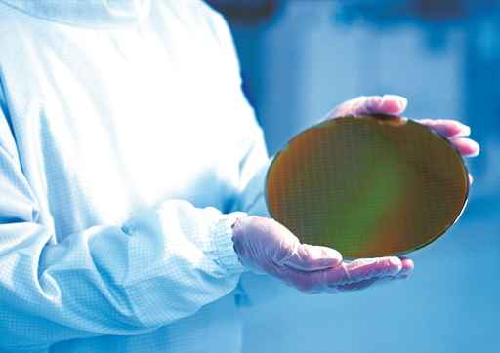
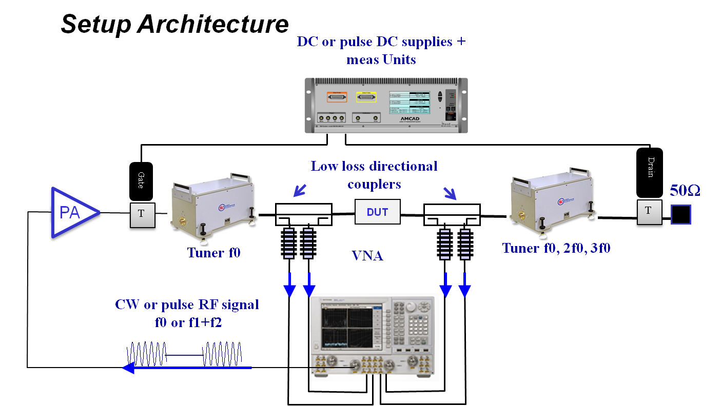
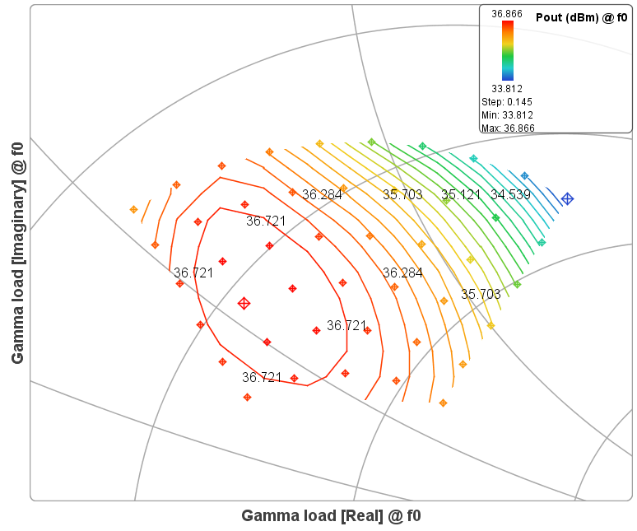
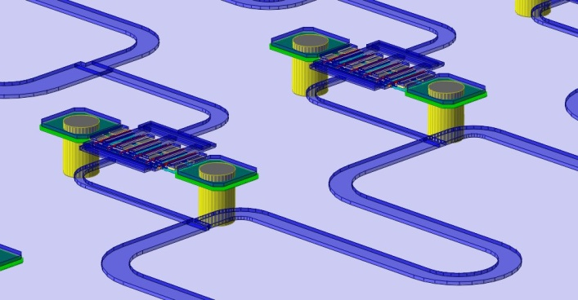
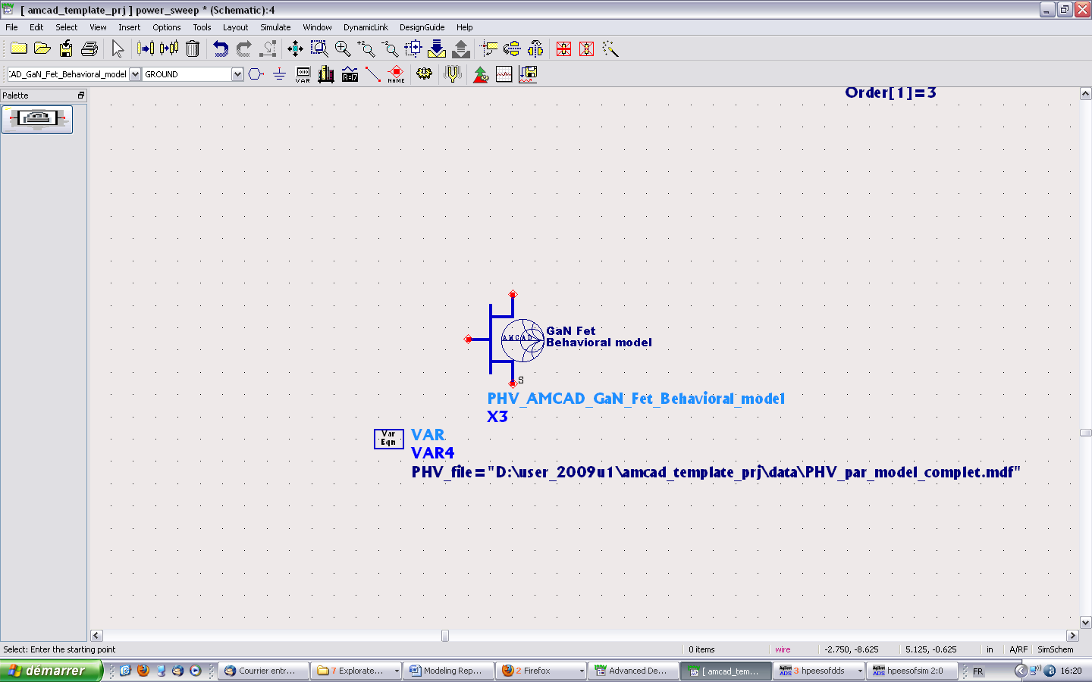
AMCAD Engineering
Founded by 3 PhDs from University of Limoges in 2004
Providing advanced solutions and tools in test and modeling to the RF & microwave IC market
18 employees, majority of PhDs
Well-known in our sector for innovation
3 – The participation of AMCAD Engineering

Slide 11
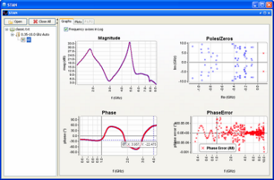
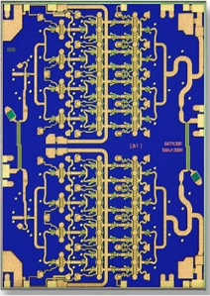
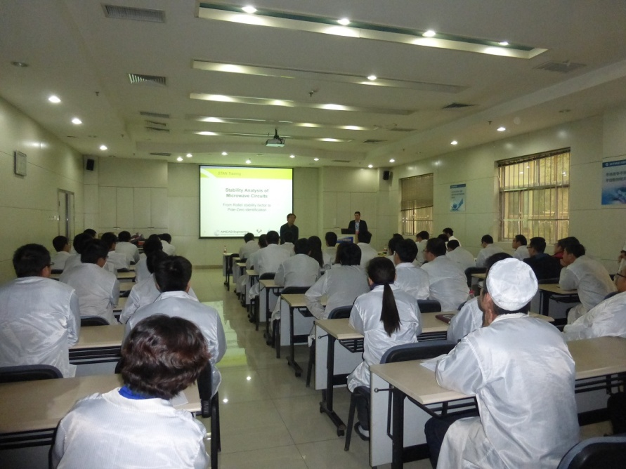

Very good fit with our product portfolio and mission
Strengths:
Innovative method with unique added value
- Patent with CNES behind
What we did:
integration in our software platform
marketing
education and customer support
worldwide sales
AMCAD and STAN
STAN tool
3 – The participation of AMCAD Engineering

Slide 12
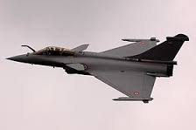
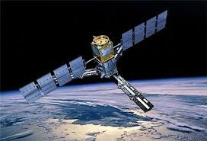


The story continues
What’s next?
AMCAD team strengthening
Build-up of more educational stuff with UPV/EHU
Partnership with Key players (National Instrument, Keysight)
With the objective to make STAN an industry standard !
3 – The participation of AMCAD Engineering

Slide 13

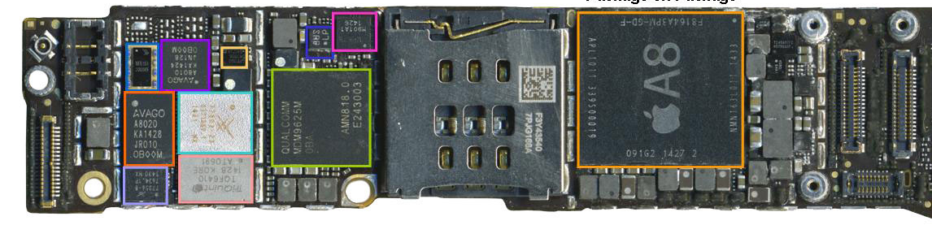
The story continues
Iphone 6 Teardown – RF parts
5 power amplifier modules provided by 3 companies
Avago
Skyworks
Qorvo
All 3 are either using STAN or under evaluation
3 – The participation of AMCAD Engineering

Slide 14
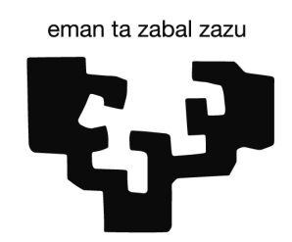
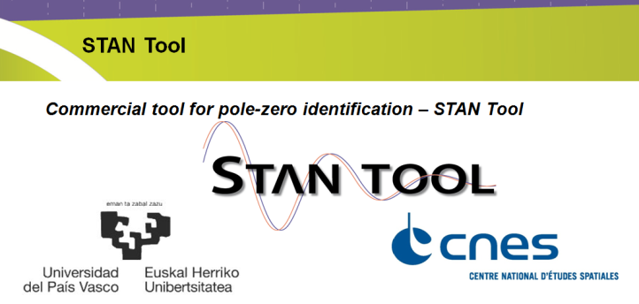
Framework agreement between the three institutions
4 - The current status-quo

Slide 15
Key point for the success:
The personal relations (the Limoges connection!) Speaking French also helped…
Motivated people (moving the lines in their respective administration)
Main challenges:
Getting bureaucracies from two Institutions – two countries – to agree. Some of the technical people involved (as Geoffroy Soubercaze-Pun from CNES) made a huge effort to put all this in place and we are grateful to them
Customer education on new method
5 - Key elements and major difficulties

