Slide 1


Cross-border assignment (CBA) – a powerful tool for university-business cooperation
Eija Källström, Arcada UAS, Helsinki
Thematic University-Business Forum, San Sebastian, 18 September 2016

Slide 2


Case Nobanet: Nordic-Baltic Network for Internationalisation of SMEs
NOBANET develops new knowledge and learning materials on successful internationalisation of SMEs
The network also provides individual support to SMEs wanting to go international
For the students, Nobanet means a more practice-oriented learning experience

Slide 3
NOBANET – partners from 8 countries
Higher Education Institutions (HEIs)
Denmark: EAL, Odense
Estonia : TTK University of Applied Sciences, Tallinn
Estonian Entrepreneurship University of Applied Sciences, Tallinn
Finland : Arcada University of Applied Sciences, Helsinki
Iceland : Akureyri Universtity/School of Business and Science, Akureyri
Latvia : Vidzeme University of Applied Sciences, Valmiera
Lithuania: Kauno Kolegija/ University of Applied Sciences, Kaunas
Norway : Westerdals – Oslo School of Arts, Communication and Technology
Sweden : School of Education and Communication at Jönköping University
Partner SMEs and entrepreneurial/trade/NGO organisations in the Nordic and Baltic countries
AIESEC in Finland
TRAL Union of Professional business graduates in Finland
Valmiera Business and Innovation Incubator, Latvia
GOI Finland Oy-GOInternational Finland

Slide 4
Nobanet pedagogical model: CBA
What is a CBA?
A cross-border assignment (CBA) links education and business over national borders in a learning environment supported by information and communication technologies (ICTs). In this environment, effective communications are created between students, faculty and company representatives, in order to carry out a specific and meaningful real-world assignment. The assignment supports the internationalisation of the company and also forms an integrated part of the student’s educational curriculum.

Slide 5
The CBAs provide a genuine learning environment, where students and SMEs work closely together across national borders
The CBAs directly link SMEs with faculty and students abroad; i.e. with their target markets

Slide 6
Examples of CBA tasks for students
Developing international market entry plans
Participating in international business fairs
Researching customers’ preferences
Producing films and case stories
Testing products and services
Identifying resource efficient logistics solutions
Comparing business support functions in different countries

Slide 7
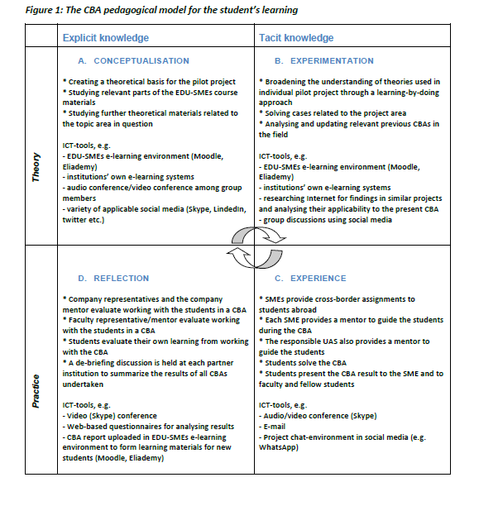

Slide 8
Main players in a CBA
1. A team of teachers/researchers in each partner school
The faulty members are the key persons who decide what assignment to accept into their courses. The assignments should be possible to accomplish in the time frame of the course (or other study module) and they should lead to learning outcomes in line with the overall aim of the course. The teacher also provides guidance to the students during the CBA.

Slide 9
Main players in a CBA
2. The SMEs that provide the CBAs
SMEs assign a business tutor to closely guide the students and answer the company-related questions that will arise
The business tutors will be available either in the Nobanet e-learning environment or on campus

Slide 10
Main players in a CBA
3. The students who conduct the CBA
Students form teams based on necessary competencies and their availability. Cooperation between students, their teacher and the SME abroad is kept through at least 3 personal contact times during the assignment:
before the start of CBA: to make sure goals are clear to both parties
mid-term of CBA: to report status and to agree on the next step
in the end of CBA: to present the final result to the company and to get feed-back on completed work

Slide 11
Nobanet deliverables so far:
Around 25 CBAs have been implemented, with very encouraging evaluation results
Handbook has been developed on´Internationalisation of Nordic and Baltic Small- and Medium-Sized Enterprises (SMEs)’. The handbook consists of the following parts
  THE SOCIO-ECONOMIC ENVIRONMENT OF THE NORDIC AND BALTIC COUNTRIES
  SMEs IN FOREIGN TRADE
  EXPERIENCE FROM PRACTICE – RESULTS FROM CBAs AND CASE STUDIES
  COURSE WORKBOOK
  The handbooks is available on NOBANET website www.nordicbalticnet.info in the Materials Development section
Model for university-business cooperation is ready
First version of Nobanet Usability Guide has been tested (regarding SME websites´ suitability for international markets)
A few research articles have been submitted for publication

Slide 12
Next steps
During the academic year 2016-2017 Nobanet focuses on e-business to support SME internationalisation
A full e-learning course on e-business (10 ECTS) will be jointly designed and delivered by the partners, and integrated into partner institutions´ courses and curricula
The Nobanet Usability Guide (NUG) will be further developed for analysing SMEs’ readiness to e-business on international markets. Students, faculty and SMEs participate in the development work.
A new pedagogical approach is introduced where students, faculty, and SMEs together develop e-shops
More HEIs and SMEs will be invited to join the network

Slide 13

For more information, please contact local project leaders in partner
countries – contact details available on Nobanet website
www.nordicbalticnet.info
or project manager:
Ms Eija Källström, Lic. Sc. (Econ)
Director International Projects
Arcada University of Applied Sciences
Jan-Magnus Janssons plats 1
FI- 00550 Helsinki, Finland
Tel. + 358 207 699 528
Fax. + 358 207 699 644
eija.kallstrom@arcada.fi

Slide 14
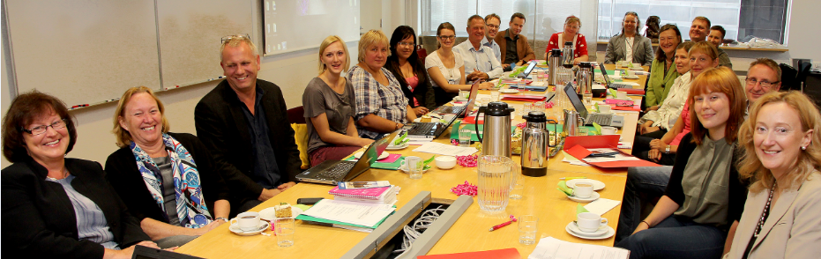

Thank you for your time and attention!
This project has been funded with support from Nordplus.
This publication reflects the views only of the author, and Nordplus cannot be held responsible for any use which may be made of the information contained there.

