Slide 1



Cooperation with Local SMEs in Times of Crisis:
A Multistakeholder Programme
Iñaki Heras
Department of Management
University of the Basque Country UPV/EHU

Slide 2
Index
Objective of the presentation
Garaituz: overview of the programme
Objectives of the programme for the UPV/EHU
Methodology and resources
Results
Related documentation and references

Slide 3

Objective of the presentation
  This short presentation aims at giving an overview of the so-called Garaituz Programme, promoted by the Gipuzkoako Foru Aldundia - Diputación Foral de Gipuzkoa in the 2014-2015 academic course.

Slide 4

2. Garaituz: overview of the programme
Firstly, a diagnosis of the situation of the local SMEs was carried out by a consultant company with the assistance of Garapen and the network of local agencies.
Secondly, taking into account the previous diagnosis, the Diputación Foral de Gipuzkoa decided to intervene in three lines:
  Line 1. Implementation of viability plans in SMEs in crisis.
  Line 2. Definition and/or re-definition of the management model and business model of the SMEs in crisis.
  Line 3. Improvement of the productive competitiveness of the SMEs.
Notes:
Taking into account the high impact of the economic crisis on the industrial sector of the province of Gipuzkoa, notably considering the case of some local very relevant and bigger companies, such as the Fagor cooperative, a consensus was stablished among the different political parties to set an anti-crisis plan by the DF.

Slide 5






Directly involved stakeholders
Consulting companies
99 Local SMEs in economic crisis
Notes:
DFG is the local public administration of the province of Gipuzkoa
Garapen is a public agency that coordinates the work of the network of the local development agencies of the Basque Country
Tknika is a centre for innovation and develoment for the professional training
Consulting companies: aprox. 30-most of them specialized in providing services to local SMEs aimed at improving their competitivness (commercial aspects; for ecample plans to become more internationalized)
Local SMEs average number of employees of 16 and most of the industrial companies
LINEAS
In the case of the first line the implementation of viability plans was carried out by the consultants firms, the second line by the UPV/EHU and the third one by Teknika. Nevertheless, considering the very small dimenssion of the companies, in many of the cases the intervention was shared among different actors, notably for lines 1 and 2. Needless to say that a very important level of coordination was stablished in both the entreprise and local level.

Slide 6
LANTALDEAK
WORKING TEAMS
LURRALDE LAN –TALDEA Province level | D.F.G./G.F.A TKNIKA UPV/EHU GARAPEN | General coordination of the project
ESKUALDE LAN-TALDEA Region-valley level | UPV/EHU TKNIKA GARAPEN-Agencia Comarcal | Coordination at the valley level Analysis of the situation in the valley Definition of a specific plan of actions for the SME
ENPRESA LAN-TALDEA SME level | Responsable empresa Persona contratada (externa o interna) TKNIKA UPV/EHU GARAPEN-Agencia Comarcal | Analysis of the situation of the SMEs Definition of a specific plan of actions for the SME Coordination of the actions
Source: adapted from Garapen

Slide 7
3. Objetives of the programme for the UPV/EHU
To give a clear added value to the local SMEs that participated in the programme.
To promote a network aimed at improving both our expertise and knowledge and the relational capital with the stakeholders that participate in the programme (SMEs, consulting firms, Garapen, Tknika, etcetera).
To give our students and recent graduates and opportunity to develop their professional knowledge, expertise and competences or abilities with an internship in the SMEs.

Slide 8

4. Methodology and resources
It was designed a specific model of cooperation and intervention adapted to the specific situation of the local SMEs aimed at:
      Generate trust
      Obtain the “real” situation of the company
      Add value in the coordinated and multistakeholder approach that was implemented
      Obtain consistent, internalized and sustainable improvements

Slide 9
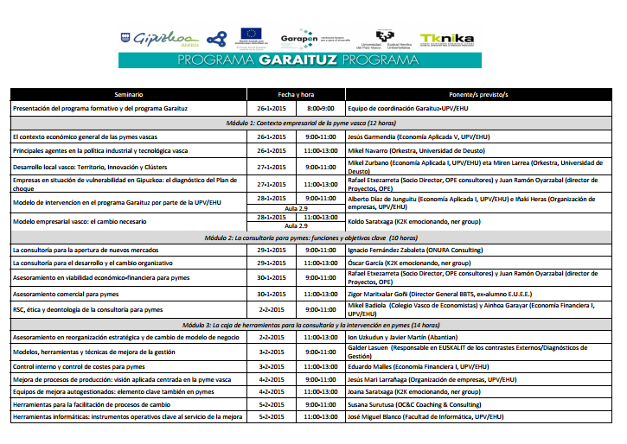
A specific formative course for the programme was designed, the so-called Programa de formación en asesoramiento a pequeñas y medianas empresas para el cambio y la mejora en la gestión (60 hours), a course that was taught by university lecturers (UPV/EHU and Deusto University) and consultants and managers with a depth expertise in the reorganization and improvement of SMEs.

Slide 10
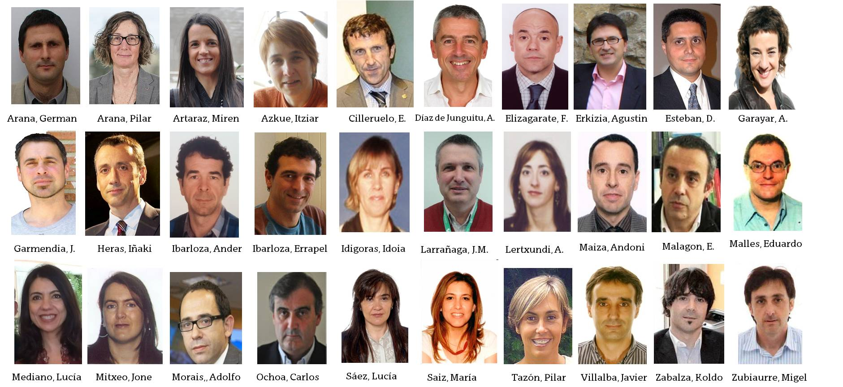
The working team of the UPV/EHU
Integrated by 33 lecturers and 84 students and recently graduated:
Lecturers of Business and Management (21), Management Engineering (9) and other degrees (3).
Graduated of the Degree/Master Business and Management (54), students of the Degree of Business and Management (12), graduated and students of Management Engineering (15) and graduated of other degrees (3).

Slide 11
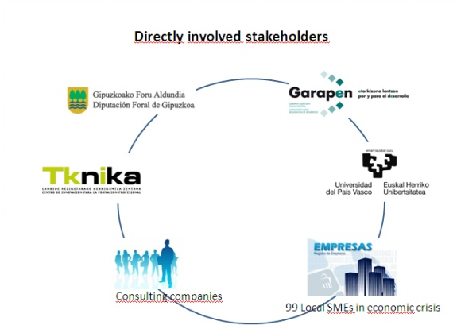
5. Results
Added value was given to the SMEs and we somehow contributed to improve their situation. The role of the students, based in the companies during their internship, was essential for the intervention of the stakeholders.

Slide 12
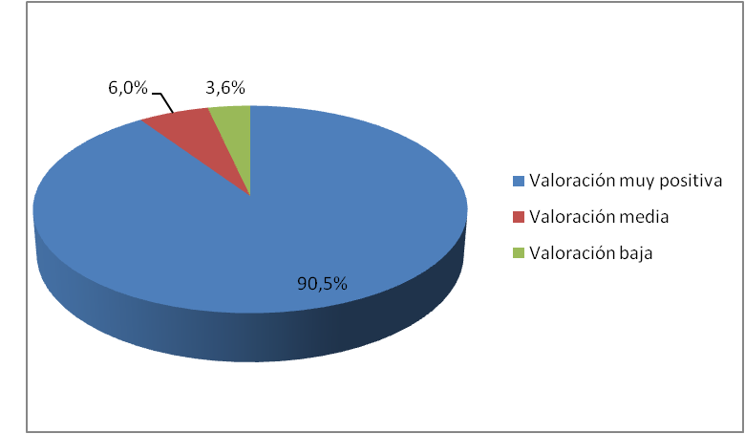
The 90,5 % of the SMEs evaluated their participation in the programme as very positive.
Source: Diputación Foral de Gipuzkoa.
Note: the total amount of companies that fulfilled the questionnaires was 84

Slide 13
2) The university lecturers also added value to SMEs in this situation, despite their contributions was rather diverse. In general terms, their role was significantly different to the one of the consultants (for example, in the case of conflicts among the general managers and/or the owners and the employees, the implementation of new technologies, etc).
3) A very relevant experience for the lecturers that participated in the programme, both in terms of knowledge acquisition and relational capital.

Slide 14




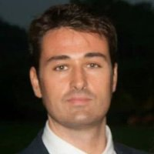

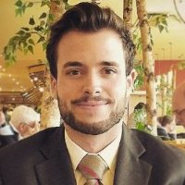
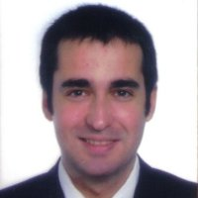


5) A relevant opportunity of industry-orientated training for students and graduated.
6) Some educational lacks and needs were detected.
7) Despite this was not a specific target of the programme, a very good rate of labor market insertion was obtained.

Slide 15
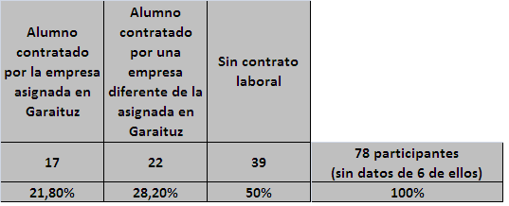
The direct labor market insertion rate was of 25,64 %. This was the rate of students and graduated that were employed by the SMEs. In many cases it has to be underlined that the position they got in the companies were of area-managers (e.g. financial managers, commercial managers), assistant to general managers, etc.
20
25,64%
Source: own elaboration.

Slide 16
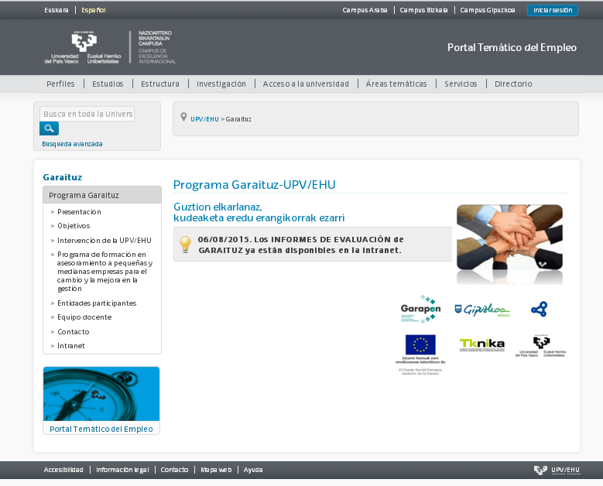
6. Related documentation and references
Website of the UPV/EHU for the Garaituz programme

Slide 17
Thank you very much for your attention!
iheras@ehu.es
Iñaki Heras
Department of Management
University of the Basque Country UPV/EHU

